Slide 1
Understanding Problem
Owners of the mall are facing problems as more people have turned into Online Shopping . So we’re to help the Stores find potential Customers.
Find the potential customers by - buying trends in age group
What kind of stores are people most interested in
What are the favorite categories of shoppers and where do they spend most time shopping
OUR AIM – We are given the co-ordinates of the shopping centers we want to map the ping location of the user to the nearest Store
We observed that some of the ping co-ordinates were outside the Shopping Centre
Someone waiting outside for a cab might that have resulted in an invalid ping.
One who have generated more pings is a frequent customer and we have to target those users
There are 9 floors of which the first 4 floors have significant amount of shops

Slide 2
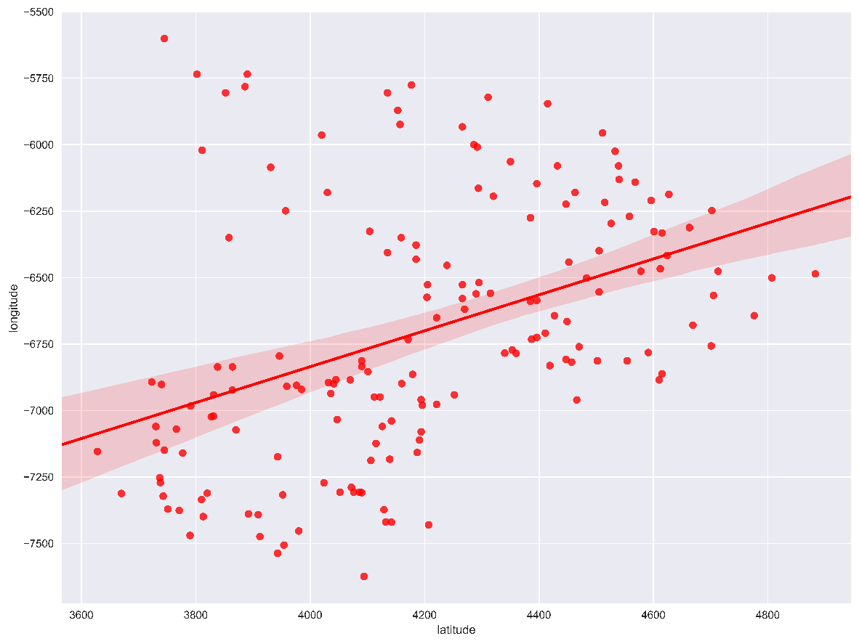
Data Processing
Scatter plot of the total shops present in mall
Pings generated outside the Shopping Mall were discarded.
Since the Standard Deviation in latitude and longitude Pings is very small so we filtered our coordinates by extracting the last 4 digits of the coordinates
Multiple pings generated by a user within a timeframe of 10 minutes in the same store were treated as a single ping
All the shop in San Francisco Centre open at 10 a.m. and closes at 8 pm and data was filtered accordingly
Of the 9 floors Shoppers never go to the top 3 floors

Slide 3
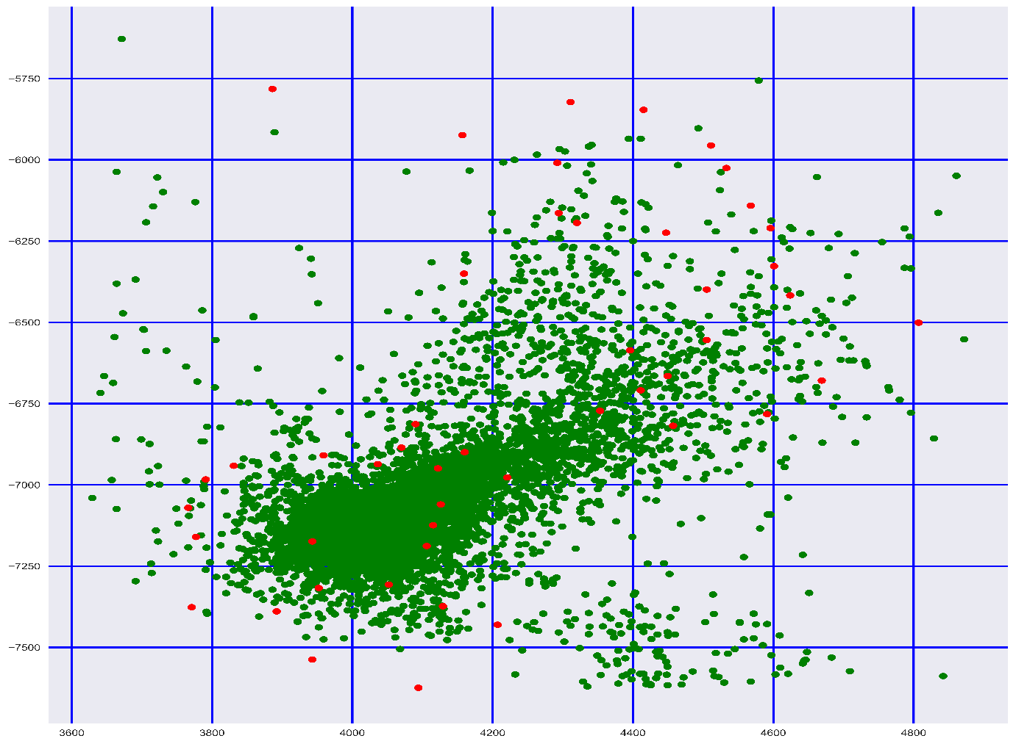
Methodology
Map the ping coordinates with the coordinates of the stores to find in which shops are most-likely to be visited by shoppers
For mapping we used the EUCLIDEAN distance on Store Mapping data and predicted the most probable store based on ping coordinates
For predicting stores ,we calculated the Euclidean distance of a ping from all the given stores and mapped in onto a store which has the least distance from the ping location.
Then merged the predicted result in Demographics and Category Mapping data

Slide 4
RESULT
Identified the top 10 store which are mostly visited by shoppers.
The adjacent graph shows Categories in which shoppers spend most time
Favorite sectio

Slide 5
Result
January and December are the favorite time of Shopping
Mall is closed during July-Sept
List of the top 13 most visited Stores

Slide 6
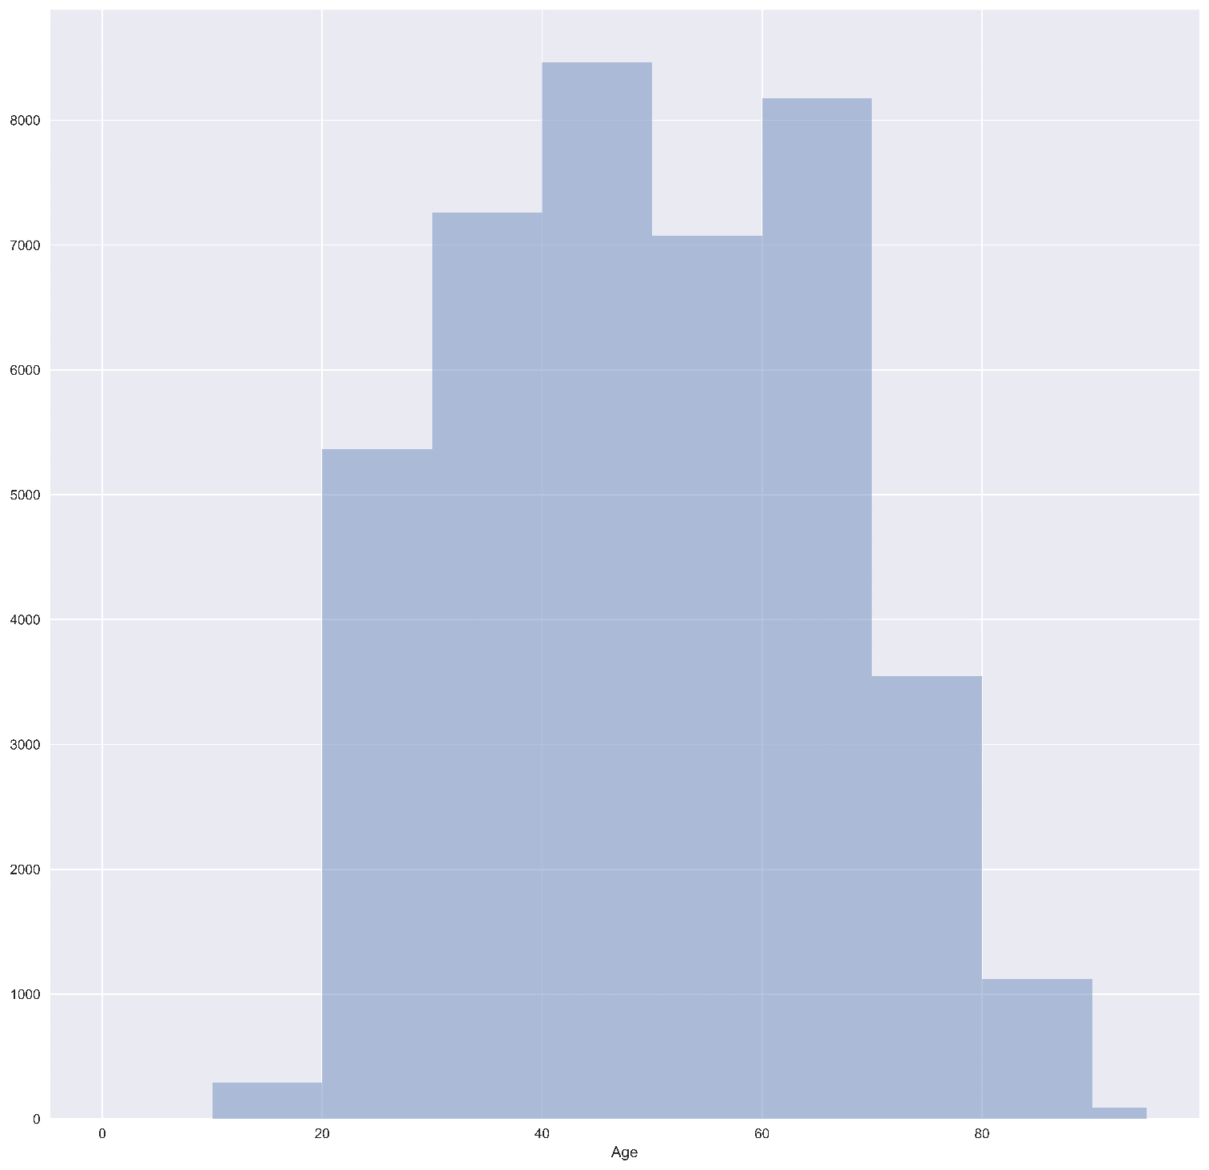
Recommendations
As suggested by Age-distribution histogram potential target customers are in a age range of 30-60

